Slide 1
WEB VITALS
Web vitals are a set of metrics that measure the performance and user experience of a web page. They are designed to provide developers with a common set of metrics to focus on, in order to improve the overall user experience of their web pages
The three main web vitals are:
1. Largest Contentful Paint (LCP)
2. Cumulative Layout Shift (CLS)
3. Interaction To Next Paint (INP)

Slide 2
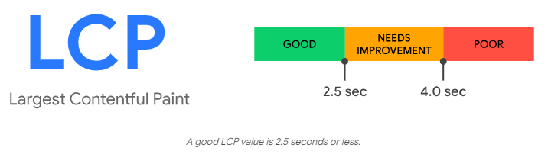
1.Large Contentful Paint (LCP)
The Largest Contentful Paint (LCP) metric report the render time of the larges images or text block visible within the viewport, relative to when the page first started loading

Slide 3
The different types of elements considered for Largest Contentful Paint (LCP)
<img> elements (image should be compressed such png,jpeg,svg,webp)
<image> elements inside an <svg> element
<video> elements (the poster image load time)
An element with a background image loaded using the url() function, (as opposed to a CSS gradient)
Block-level elements containing text nodes or other inline-level text element children.

Slide 4
What Causes a Low LCP Score?
LCP is primary affected by four factors:
Slow server response times:- When a website server is slow to respond to a browser request, the largest content elements can take more time to render
Render-blocking JavaScript and CSS :-Certain page elements (scripts, stylesheets, cookie banners, page-building blocks on WordPress sites, etc.) can block the process of displaying an HTML page. This causes a delay in loading website content
Resource load times:- High-definition images take more time to load compared to text. Placing images above the fold (the top portion of a webpage that’s visible without scrolling) can have a negative effect on LCP
Client-side rendering:- Using client-side rendering can result in slower load times, especially when it involves a large amount of JavaScript or when the content is loaded for the first time in a user’s browser

Slide 5
Solution for Largest Contentful Paint Issues
Optimize Images:-Images—
especially large, high-definition ones—can take a while to load. This can negatively affect your LCP score.
To help images on your website load faster, consider resizing them to smaller dimensions and then compressing them using tools like Kraken or Optimizilla.
Apart from resizing and compressing PNG and JPG images, consider opting for a more performance-friendly image format, such as WebP.
WebP images can be up to 34% smaller than PNG and JPG images, with little to no loss in quality

Slide 6
2. Optimize Fonts:-
Stick to system fonts:- System fonts, also called web-safe fonts, are the default fonts on a user’s device.
Use "font-display:optional." :- By setting the "font-display" attribute to "optional," you let the user’s web browser know that using a web font is optional. If the web font isn’t loaded by the time the page needs it, the text will be displayed using a fallback font
3. Minify JavaScript, CSS, and HTML Files:- Minification is the process of optimizing code to make it more compact. When you minify code, you remove things like line breaks, unnecessary white space, and comments made by developers.
This results in smaller scripts and files that load more quickly
4. Remove Render-Blocking JavaScript and CSS Code:-
A web browser starts parsing an HTML file and needs to stop when it encounters a CSS or JavaScript file. Then, it fetches said file before continuing to parse the HTML code . This can slow down your website and result in a poor LCP score.
Websites can sometimes unnecessarily load large bundles of JavaScript and CSS files. For example, there might be some leftover code that’s no longer used

Slide 7
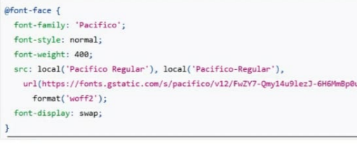

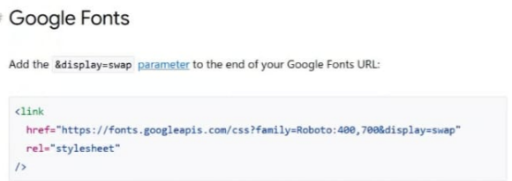

Slide 8
2.Cumulative Layout Shift (CLS)
To provide a good user experience, must should maintain a CLS of 0.1. or less
CLS is your websites layout visual stability metrics which is very important in Core web vitals.
And high impact on user satisfaction and how they interact with your website.
In easy term when something unexpected design change happens on the screen that is CLS.
When elements change the place unexpectedly is that is CLS

Slide 9
What Causes CLS?
1.Images ,ads,iframes without dimensions.
2.Dynamic content added to the page which moves the elements on the page.
3. Webfonts changing the size of the element/block
How to solve CLS?
Always includes size attributes on your images and video elements.
<img src=“img.jpg” alt=“tesrimages” width=“500” height=“600”/>
2.Reserve enough space in the case of the ads.
3. Never Insert content above existing content ,expect in response to a user interaction.
4. Prefer to transform animations to animations of properties layout changes on the page.

Slide 10
3. Interaction To Next Paint (INP)
INP is more than about first impressions .By sampling all interactions, responsiveness can be assessed comprehensively, making INP a more reliable indicator of over all responsiveness than FID.
INP aims to represent a page overall responsiveness by measuring all click ,tap ,and keyboard interaction made with a page.
To provide a good user experience, must should maintain a INP of 200ms. or less
Which evens involved in calculating INP score?
Clicking with a mouse
Tapping on a device with a touchscreen.
Pressing a key on either a physical or on Screen keyboard.

Slide 11
How to improve INP?
Improving INP during page startup.
Improving INP after page startup
Remove Unused code:- You should not have JS,CSS code you are not using on website
Find code-splitting opportunities:- Don’t merge JS and CSS file and load only required JS and CSS during the Page Load ,Rest everything should be lay loaded in chunked
Identify slow third party JavaScript :- Remove And replace slow on website.

Slide 12
OTHER NOTABLE METRICS
FIRST CONTENTFUL PAINT (FCP)
FIRST INPUT DELAY (FID)
TIME TO FIRST BYTE (TTFB)

Slide 13
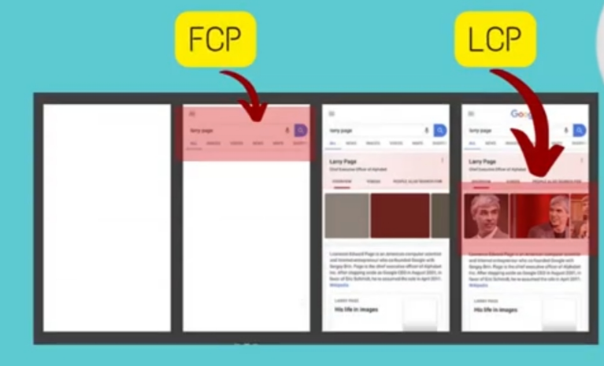
FIRST CONTENTFUL PAINT (FCP)
The First Contentful Paint (FCP) metric measures the time from when the page starts loading to when any part of the page’s content is rendered on the screen .For this metric ,”content ” refers to text,images (including background images ),<svg> elements, or non-white <canvas> elements.
To have FCP score of 1.8sec or less

Slide 14
HOW TO IMPROVE FCP?
Eliminate render-blocking resources
Minify CSS
Remove unused CSS
Preconnect to required origins
Reduce server response times (TTFB)
Avoid multiple page redirects
Preload key requests
Avoid enormous payloads
Serve static assets with an efficient cache policy
Avoid an excessive DOM size
Minimize critical request depth
Ensure text remains visible during webfont load
Keep request counts low and transfer sizes samll

Slide 15
2.TIME TO FIRST BYTE (TTFB)
TIME BLOCKING TIME(TBT)
TBT score should be is 200ms or less than
SOLUTIONS:-
Keep website lighter
Don’t merge JS and CSS files together
Use async /defer attribute for individual JS files
Reduce the impact of third party code
Reduce JavaScript execution time.
Only send the code that your users need by implementing code splitting
Minify and compress your code
Remove unused code.
Minimize main thread work
Reduce the scope and complexity of style calculations and avoid large, complex layouts
Keep request counts low and transfer sizes small self explanatory

Slide 16
REPORT FOR HEALTHTRIP WEBSITE

Slide 17
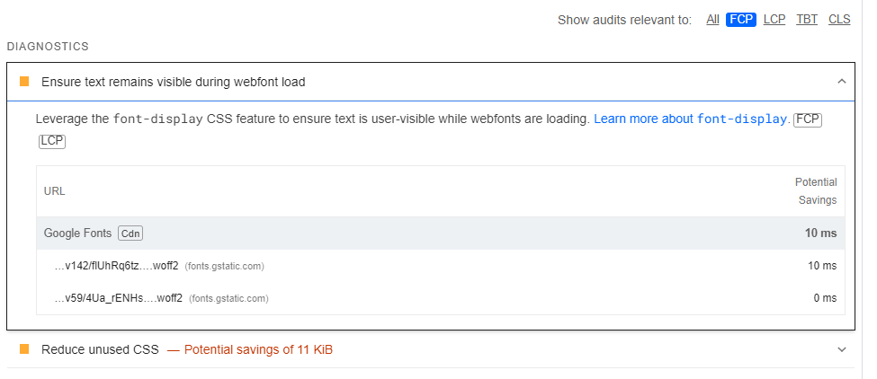
FCP FOR MOBILE MODE
SOLUTION
Use font-display:”swap” in your css
If you are using Google fontawosme write display swap like this <link href="https://fonts.googleapis.com/css2?family=Roboto&display=swap" rel="stylesheet" />
If you web font are using add preload properties in links like this <link rel="preload" href="/assets/Pacifico-Bold.woff2" as="font" type="font/woff2" crossorigin>

Slide 18
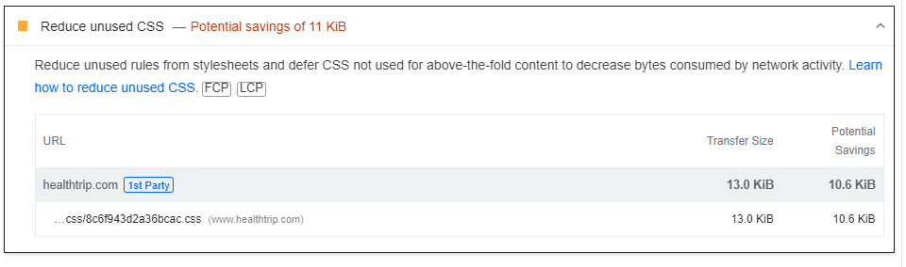
SOLUTION
Minify CSS
Remove unused CSS
Avoid multiple pages redirect
Avoid an excessive DOM Size
Ensure text remains visible during webfont load
NOTE :- A good FCP score is 1.8 seconds or less.

Slide 19
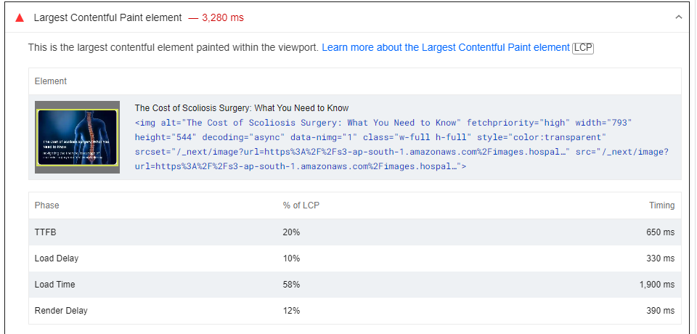
LCP FOR MOBILE MODE
A good LCP score is 2.5 seconds or less.
Solutions
Optimize the size of image it should be webp format.
Also optimize content of size

Slide 20
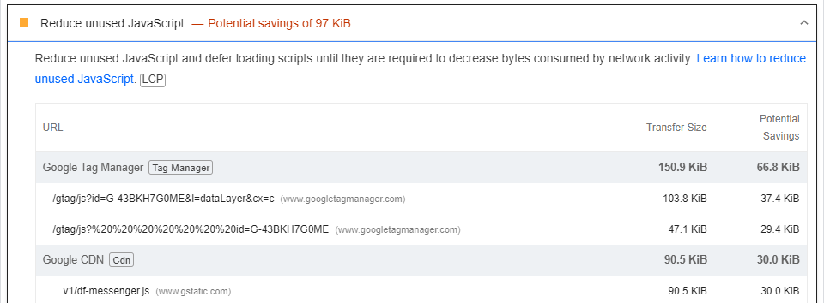
Solutions:-
Remove unused JavaScript logic
Also use CDN Link instead of download third party library

Slide 21
TASK BLOCKING TIME(TBT) FOR MOBILE MODE
For all TBT problem please follow below solutions
Keep website lighter
Don’t merge JS and CSS files together
Use async /defer attribute for individual JS files
Reduce the impact of third party code
Reduce JavaScript execution time.
Only send the code that your users need by implementing code splitting
Minify and compress your code
Remove unused code.
Minimize main thread work
Reduce the scope and complexity of style calculations and avoid large, complex layouts
Keep request counts low and transfer sizes small self explanatory

Slide 22
FOR DESGTOP MODE DID NOT NEED TO FIX PROBLME BECAUSE WHEN YOU FIX PROBLEM TO MOBILE AUTOMATICALLY FIX PROBLEM FOR DESKTOP MODE.

